Slide 1
The CREDO stack: from arguments to decisions to cognitive agents
John Fox and many friends, including Mike Clark, Subrata Das, David Glasspool, Paul Krause, Simon Parsons, Simon Ambler, Morten Elvang-Goransson, Elizabeth Black … Rick Cooper, Peter Yule … Andrzej Glowinski, Vivek Patkar, Mike O’Neil … and mentors Allen Newell, Herb Simon, John Morton, Donald E Broadbent, Ulric Neisser

Slide 2
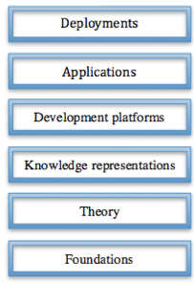
The CREDO stack
A long term programme of research on reasoning, decision-making, planning and other cognitive capabilities.
Medical expertise is the “model” domain.
Programme started with a focus on human decision-making and evolved into an AGI project and autonomous, cognitive agents.

Slide 3
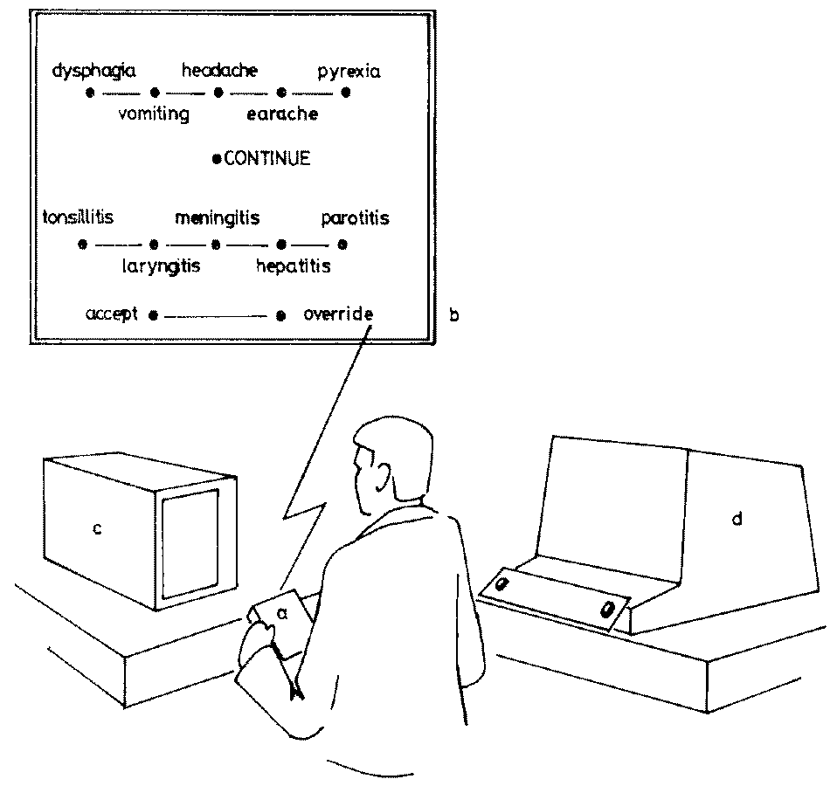
Experimental research on medical decision-making
Explain
temperature …
Symptoms
temperature …
Question:
“is headache present?”
Suspect meningitis,
tonsillitis ...
Diagnosis?
Find out ..
headache,
dysphagia…
Query
Making decisions under the influence of memory
Psychological Review, 1980

Slide 4
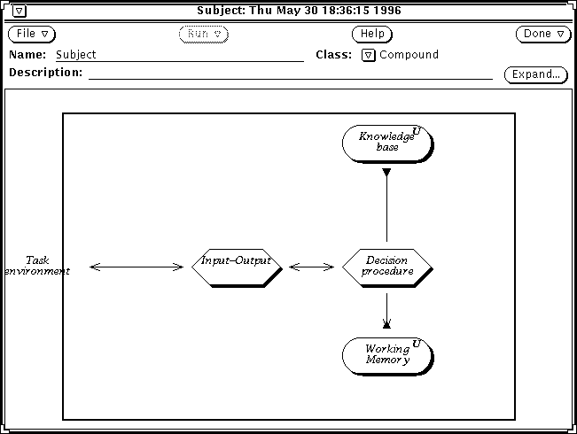
Simulation, as a simple cognitive architecture

Slide 5
The CREDO stack

Slide 6
Generalisation
Das, Fox et al J Exp. Theor. AI 1997,
Fox and Das, AAAI and MIT Press 2000
Fox et al IEEE Intelligent Systems, 2006
Goals
Beliefs
Actions
Candidate
solutions
-
Decisions
Plans
Evidence and
argumentation
Notes:
Another multi-agency funded project called RED (Rigorously Engineered Decisions) led to the development of the “domino agent” architecture which has influenced a great deal of our theoretical thinking and technology development for approaching 15 years.

Slide 7
BDI agent
Desires
Beliefs
Intentions

Slide 8
Formalisation
Das, Fox et al J Exp. Theor. AI 1997,
Fox, and Das, MIT Press 2000
Fox et al IEEE Intelligent Systems, 2006
Goals
Beliefs
Actions
Commit
(accept)
Candidate
solutions
-
Decisions
Plans
Support
Commit
(adopt)

Slide 9
Support and decision
Argumentation
Theory U Data _{LA} (Option, Rationale, Confidence)
Confidence: quantitative, semiquantitative, logical, linguistic
Decision making
{(Option, Rationale, Confidence)} →_{Agg} (Option, Commitment)
Fox et al ECAI 1992, UAI 1994
Krause et al Computational Intelligence 1995

Slide 10
Logical confidence
P is Ω
if P is any well-formed formula in the language of the logic
P is Σ
if an argument, possibly using inconsistent data, can be constructed
P is Ψ
if a consistent argument can be constructed (we may also be able to construct a consistent argument against)
P is Π
if a consistent argument can be constructed for it, and no consistent argument can be constructed against it.
P is Κ
if it satisfies the conditions of being Π and, in addition, no consistent arguments can be constructed against any of the premises used in its supporting argument
P is Γ
if it is a tautology of the logic (meaning that its validity is not contingent on any data in the knowledge base).
Based on Elvang-Gorannson, Krause and Fox “Logic and linguistic uncertainty terms” Proc. UAI (1993)

Slide 11
Logical confidence
P is open
if P is any well-formed formula in the language of the logic
P is supported
if an argument, possibly using inconsistent data, can be constructed
P is plausible
if a consistent argument can be constructed (we may also be able to construct a consistent argument against)
P is probable
if a consistent argument can be constructed for it, and no consistent argument can be constructed against it.
P is persuasive
if it satisfies the conditions of being probable and, in addition, no consistent arguments can be constructed against any of the premises used in its supporting argument
P is certain
if it is a tautology of the logic (meaning that its validity is not contingent on any data in the knowledge base).
Based on Elvang-Gorannson, Krause and Fox “Logic and linguistic uncertainty terms” Proc. UAI (1993)

Slide 12
The CREDO stack

Slide 13

Knowledge engineering
Expert systems, Personal care agents
Agents
Care pathways, workflows
Plans
Options, evidence, preferences
Decisions
Alerts, reminders, interpretations,
recommendations
Rules
Medical knowledge, Clinical notes
Descriptions
Class hierarchies, semantic networks
Diseases, Symptoms, Findings, Drugs
Concepts
Terminologies, coding systems

Slide 14
Software engineering
Enquiries
Actions
Goals
Beliefs
Actions
Actions
Decisions
Plans
Candidate
solutions
-
Commitments
Plans
Decisions
Plans
Artificial Intelligence in Hazardous Applications
J Fox and S Das, AAAI & MIT Press 2000

Slide 15
Modelling decisions
decision :: 'Diagnosis_decision' ;
caption ::"Diagnosis decision";
candidate :: ''peptic ulcer'' ;
argument :: for,age < 35 OR weight = normal attributes
argument_name :: 'age < 35 OR weight = normal' ;
end attributes;
recommendation ::netsupport(decision_11, 'peptic ulcer') >= 1;
candidate :: 'cancer' ;
argument :: for,biopsy = abnormal attributes
argument_name :: 'biopsy = abnormal' ;
end attributes;
argument :: for,age >= 50 AND Weight = down attributes
argument_name :: 'age >= 50 AND Weight = down' ;
caption ::"Elderly patient has lost weight";
end attributes;
recommendation ::netsupport(decision_11, 'cancer') >= 1;
end decision.
Sutton and Fox, J Am Med Informatics, 2003
Fox et al, AI Communications, 2003

Slide 16
Modelling plans
plan :: 'Simple_plan_example' ;
caption :: "Example of a plan with 4 components";
abort ::patient_discharged = yes;
terminate ::patient_recovered = yes;
component :: 'Diagnosis_decision' ;
schedule_constraint :: completed('Patient_history') ;
number_of_cycles ::1;
component :: 'Patient_history' ;
number_of_cycles ::1;
component :: 'Pathway_1' ;
schedule_constraint :: completed('Diagnosis_decision') ;
number_of_cycles ::1;
component :: 'Pathway_2' ;
schedule_constraint :: completed('Diagnosis_decision') ;
number_of_cycles ::1;
end plan.
Sutton and Fox, J Am Med Informatics, 2003
Fox et al, AI Communications, 2003

Slide 17
The CREDO stack

Slide 18
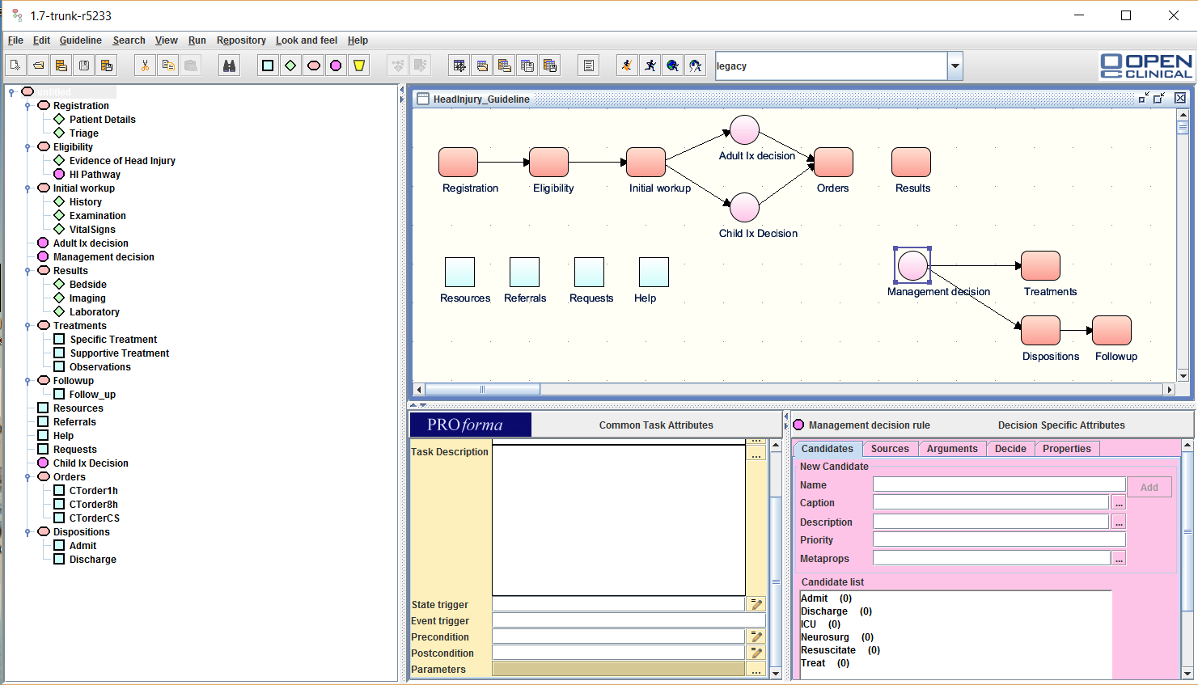
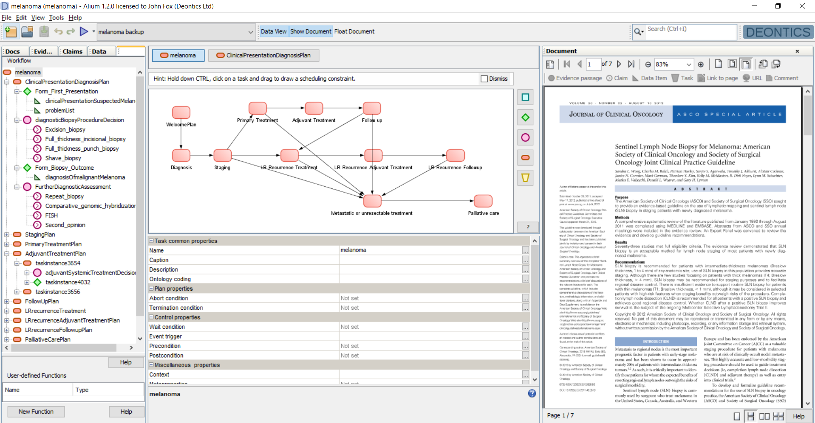
Application development platform

Slide 19
The CREDO stack

Slide 20
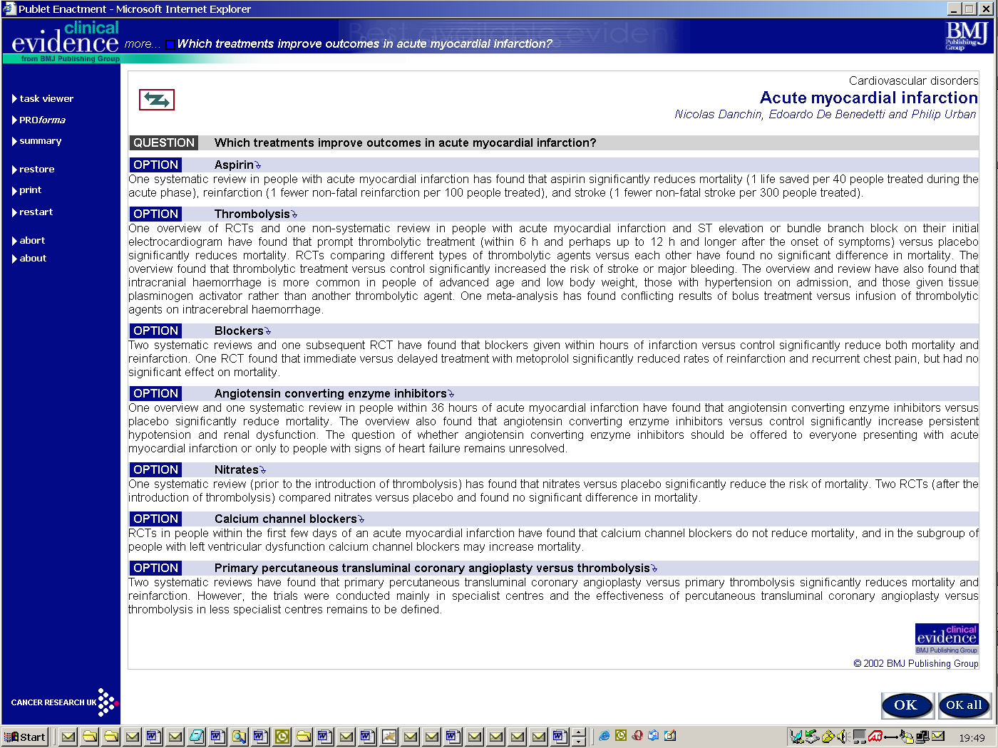
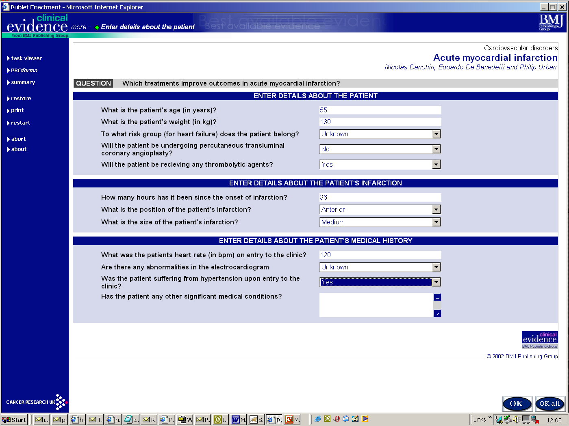
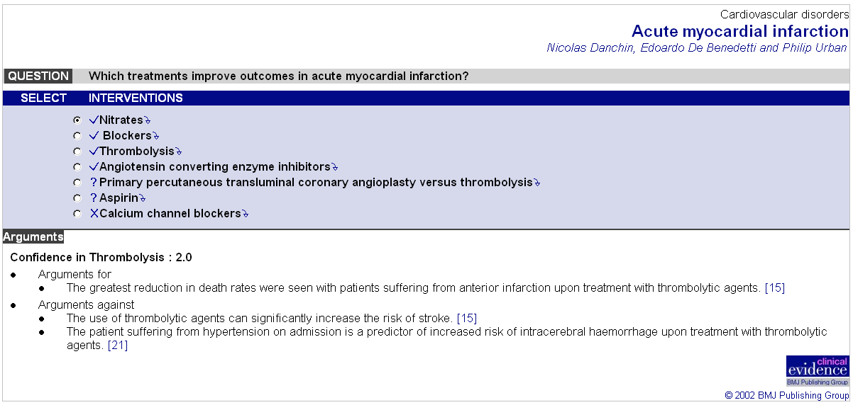

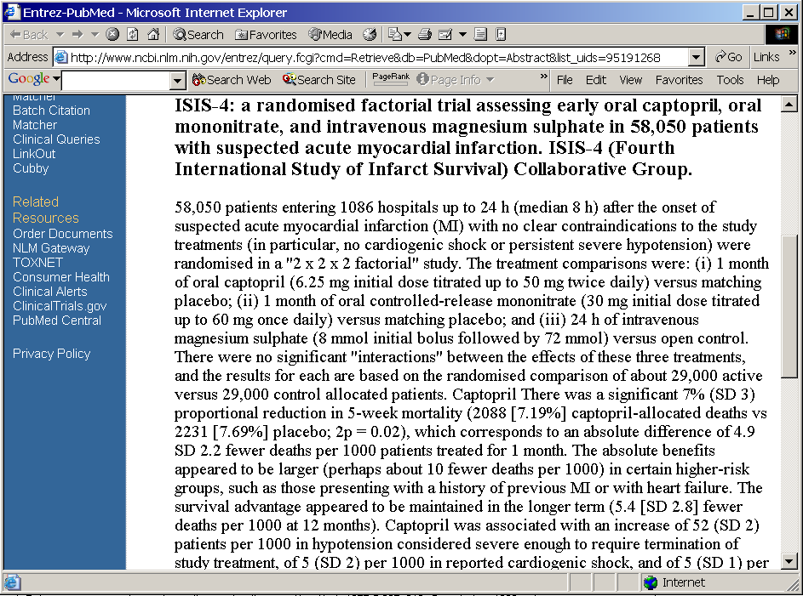
Argumentation in the evidential mode
Backings
Claims
Rationale
(pros and cons)

Slide 21
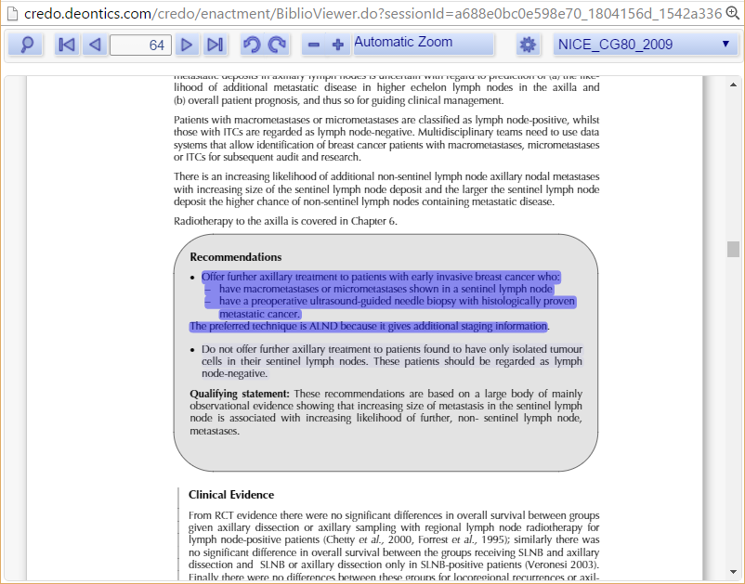
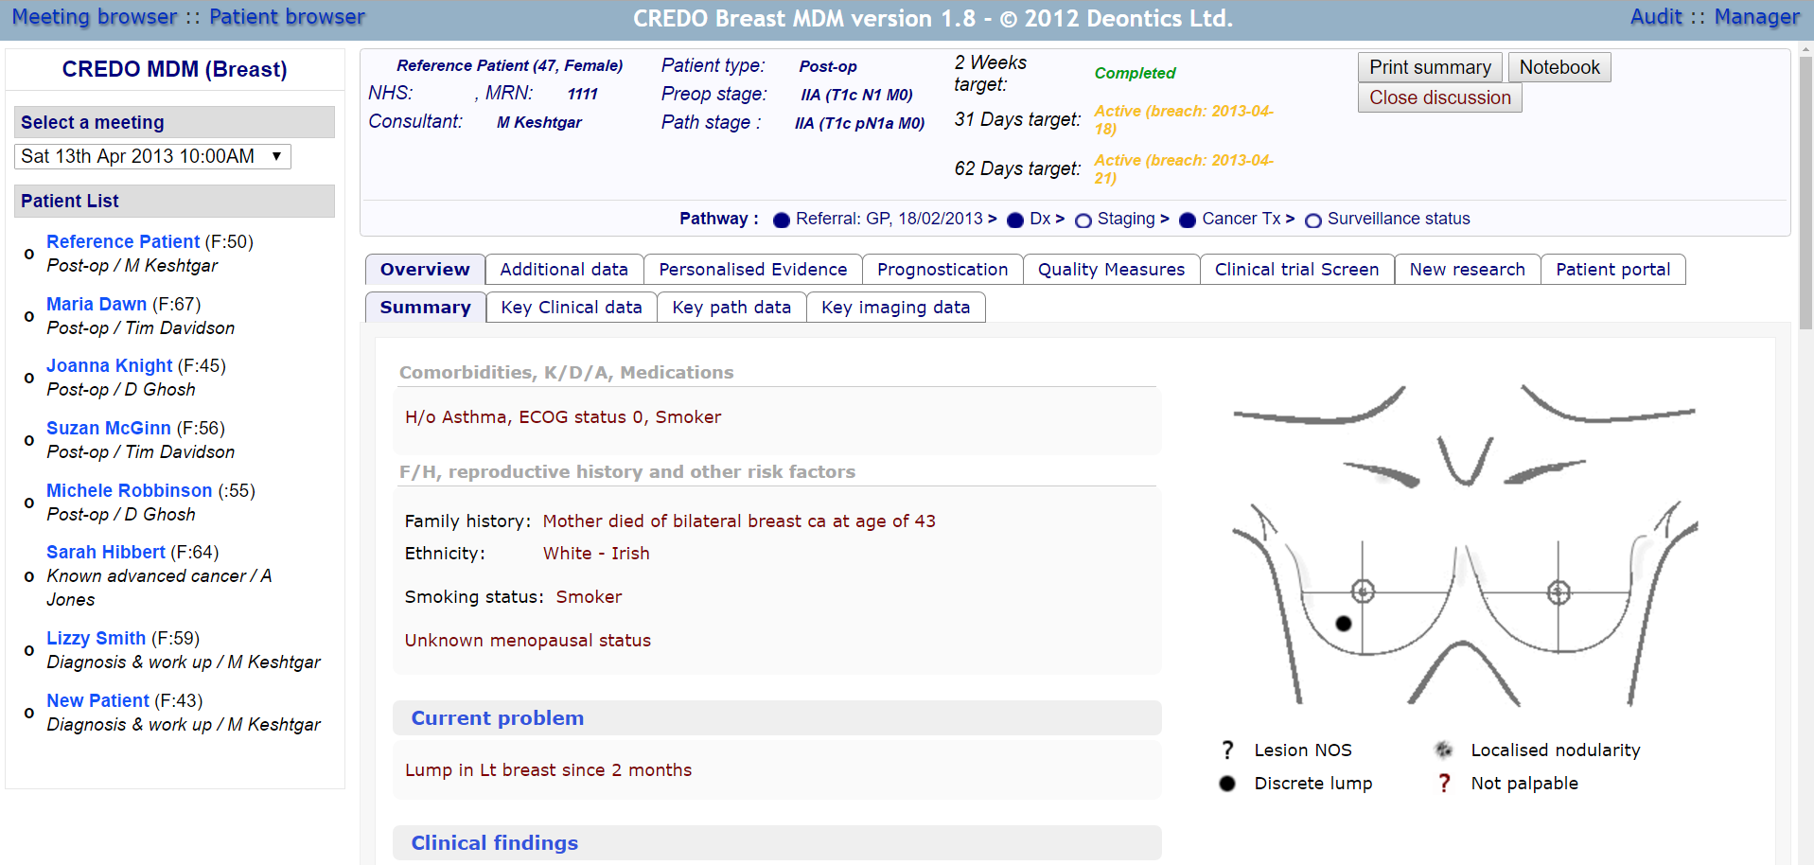

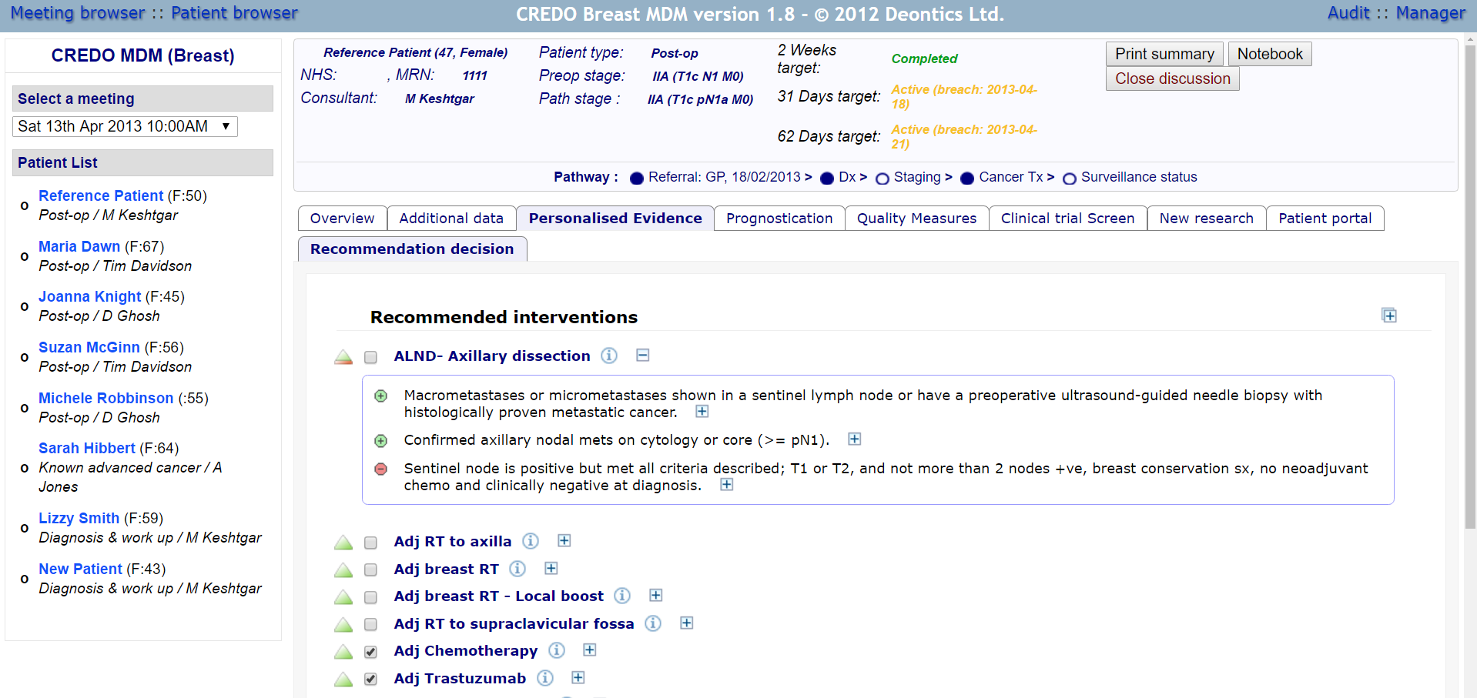
Argumentation in the evidential mode
Vivek Patkar
Dionisio Acosta
Ioannis Chronakis

Slide 22
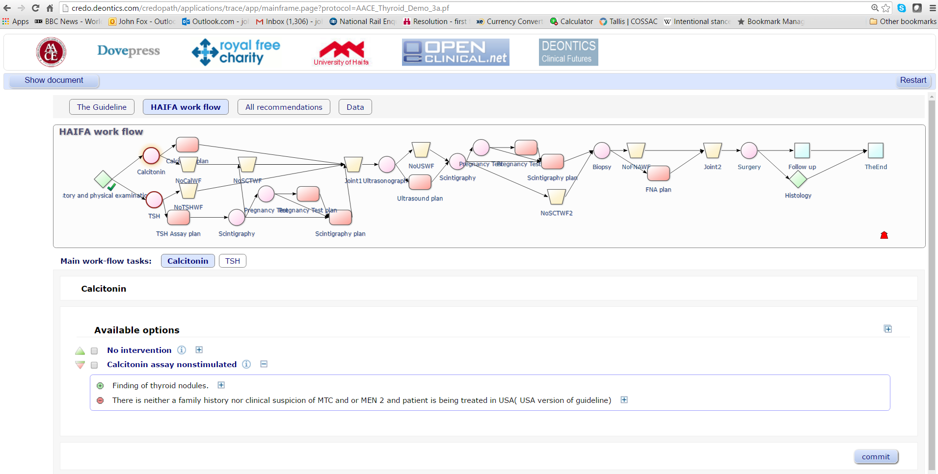
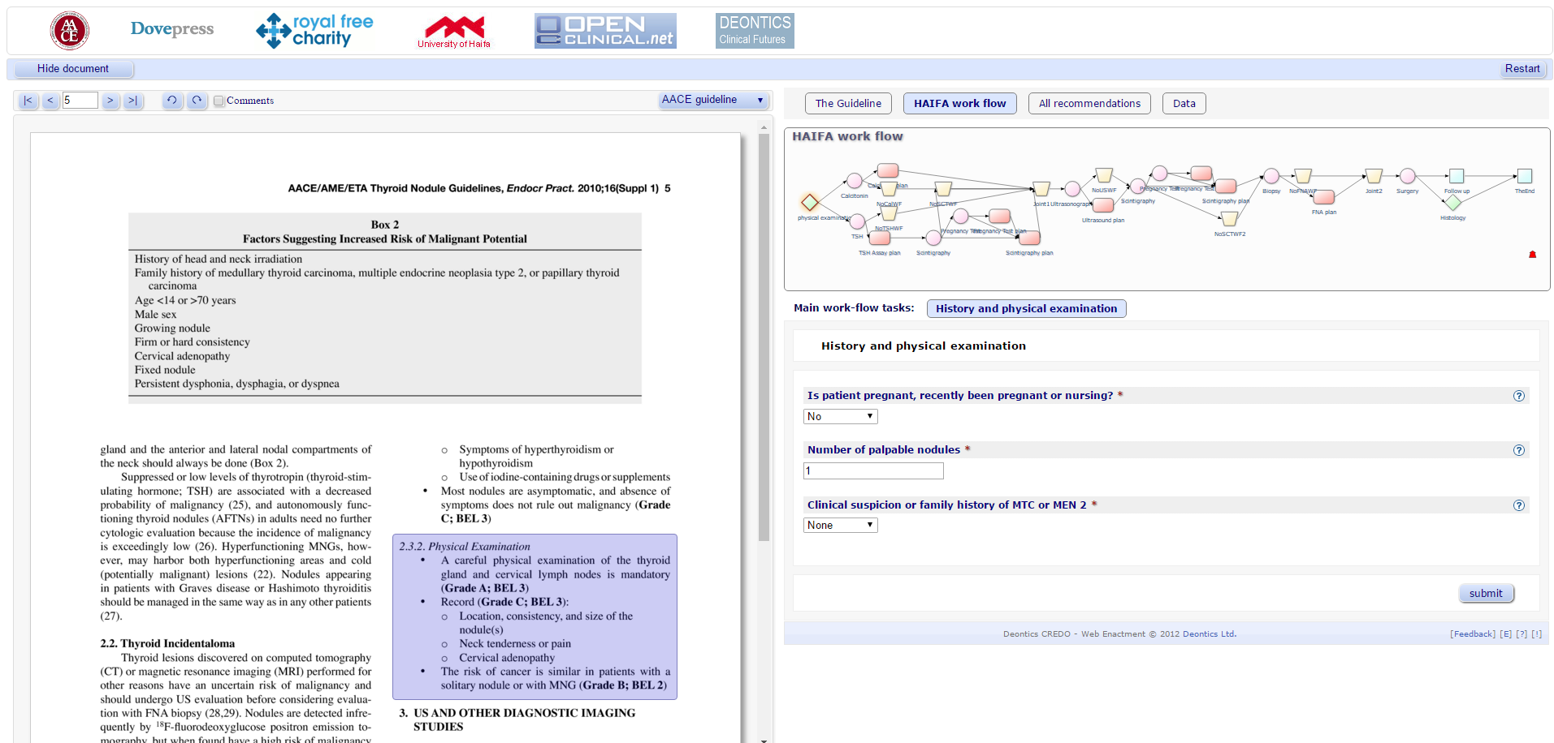
Argumentation in the evidential mode
Jeff Garber AACE, Vivek Patkar,
Mor Peleg U Haifa, David Glasspool

Slide 23
The CREDO stack

Slide 24
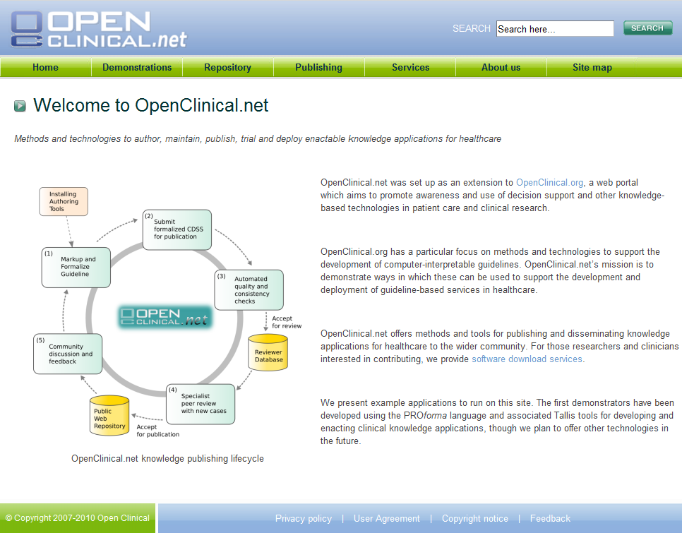
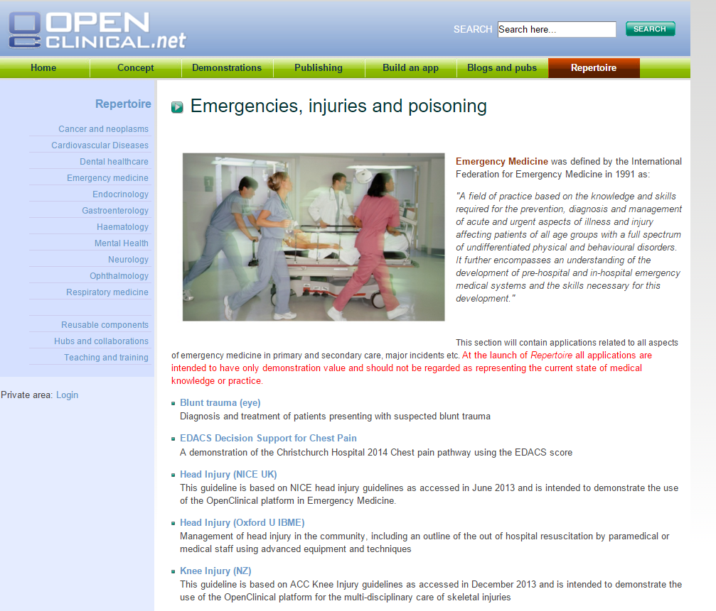
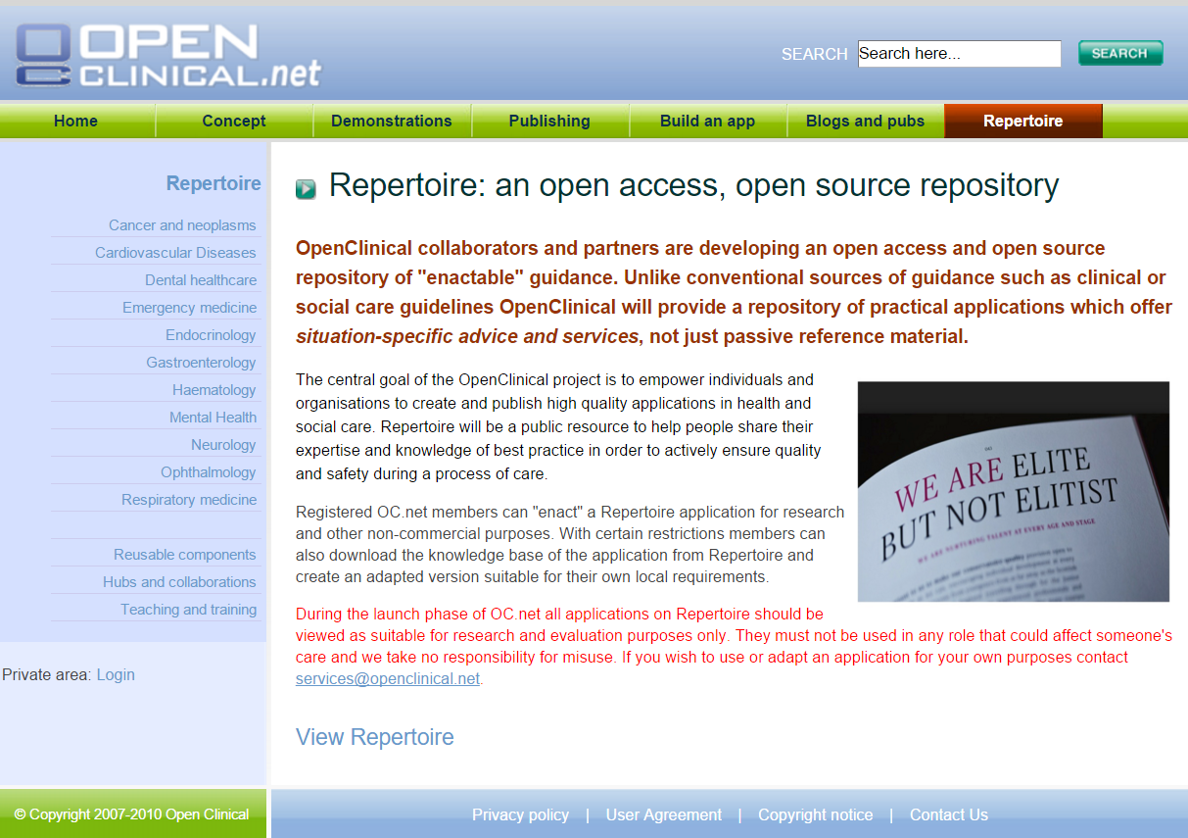
Deployments: argumentation at scale?

Slide 25
CREDO on argumentation
What is an argument?
  A process in which an agent applies its knowledge to reasoning about beliefs, goals, options, commitments, plans, actions …
What is the form of an argument?
  Claim + Rationale + Confidence
What is a good argument?
  Soundness + veracity + provenance
What modes of argumentation are there?
  Dialectical, Evidential, …?

