Slide 1
Gorgias­B
Argumentation in Practice
Nikolaos Spanoudakis , Technical University of Crete,
nikos@amcl.tuc.gr
Antonis Kakas, University of Cyprus
antonis@ucy.ac.cy
Pavlos Moraitis, LIPADE, Paris Descartes University
pavlos@mi.parisdescartes.fr

Slide 2
Contents
Argumentation in Practice - Real-life Applications
SoDA: “Software Development for Argumentation”
Demo of Gorgias-B to support SoDA – Seller Agent
Preference-based argumentation framework of Gorgias
Demo of Call Assistant in Gorgias-B: Cognitive Assistants.

Slide 3
Motivation
Argumentation has matured for real-life applications
  Argumentation for Cognitive Systems
Argumentation can benefit from a Systematic Software Development Methodology
Real-life applications of Gorgias informs the SoDA methodology
Gorgias-B is developed as a tool to enable applications of argumentation via the SoDA methodology.

Slide 4
Example application policy
A seller agent policy is given as follows:
  “Normally, sell a product at its high price.
  You can sell a product at the lower price only if payment is
  cash. Normally prefer to sell high.
  Regular customers can be offered the low price.
  Also the low price can be offered if the buyer can have
  late delivery.
  In high season you must sell at high prices.”
How can we capture this in an argumentation theory?

Slide 5
Seller Agent
Gorgias-B demo

Slide 6
SoDA methodology
In SoDA we need to consider the following questions:
  What is the decision problem? What are the options?
  What should we use as the object level arguments?
  What are the possible scenarios given the object-level argument rules?
  What are the contexts that refine the scenarios?
  Is the model/representation complete?
  How do we extend the model?
    With new refinement contexts (in existing scenarios)
    With new scenarios.

Slide 7
SoDA methodological process
In SoDA the developer follows threads:
  Considers an application scenario
  States expected (preferred) output/decision
    Either unconditionally
    Or in a Context that further refines the scenario
  Returns to (1) to consider the refined scenario(s)
Termination of a thread:
    At 2.1 with thread “end-open”
    When refined joint scenario is inconsistent with “end-final”
Threads can fork at point 2.1
  Different expected decisions under different contexts

Slide 8
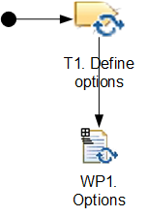
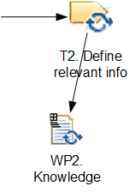
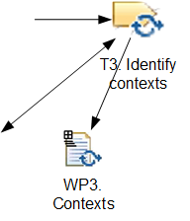
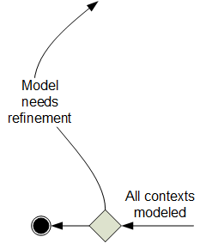
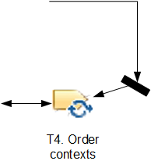
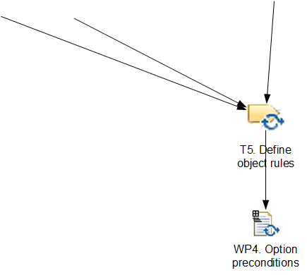
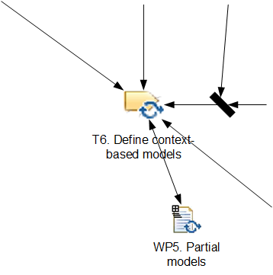
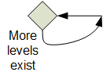
The methodology activities

Slide 9
The thread generation process
CHOOSE A PAIR OF OPTIONS: O_{i} , O_{j}
(from WP1)
START
YES
CHOOSE SET OF CONDITIONS C_{i}, C_{j} s.t.
Choose O_{i} when C_{i}, ∧ choose O_{j} when C_{j}
∧ S¹= C_{i} ∪ C_{j} is consistent
(from WP4)
C_{ij}=∅ ∨ C_{ji} =∅
NO
END-THREAD-OPEN
K=K+1
END-THREAD-FINAL
K=1
S^{K} =S^{K-1}∪ C^{K-1}_{ij} ∪ C^{K-1}_{ji}
NO
CHOOSE CONDITIONS C_{ij}, C_{ji} s.t.
O_{i} ≻O_{j} when S^{K}∪ C^{K}_{ij} is consistent
O_{j} ≻O_{i} when S^{K}∪ C^{K}_{ji} is consistent
(from WP3, level K)
S^{K} consistent
YES

Slide 10
Cognitive Assistants
Call Assistant Demo
A call assistant behaviour policy is given as follows:
“In general all calls are accepted. When at work I do not want to take family calls. However, if they are from my son I do want them but not when I am in a meeting. If he is at school and I believe that he is ill I want to take the call even if I am in a meeting.
I will not take a call when I am in a family outing and the call is related to business. Unless it is the case that my boss is calling, when I will take the call.”
See Gorgias-B website.

Slide 11
Cognitive Call Assistant Demo
Scenarios and Contexts in levels:
  Call: Family or Business
  State: At work or With Family
  Call From: Son; Call From: Boss
  State: Son at school; State: Family Outing
  Call From: Son;
  State: Son at school; In meeting;
  Call From: Son;
  State: Son ill;

Slide 12
Cognitive Assistants
Call Assistant Demo

Slide 13
Seller Agent Gorgias Code
complement(sell(Prd, Ag, high), sell(Prd, Ag, low)).
complement(sell(Prd, Ag, low), sell(Prd, Ag, high)).
rule(r1(Prd, Ag, high), sell(Prd, Ag, high), []).
rule(r2(Prd, Ag, low), sell(Prd, Ag, low), [pay_cash(Ag, Prd)]).
rule(p1_r1_r2(high, Prd, Ag), prefer(r1(Prd, Ag, high), r2(Prd, Ag, low)), []).
rule(p2_r2_r1(Prd, low, Ag), prefer(r2(Prd, Ag, low), r1(Prd, Ag, high)), []):-regular(Ag).
rule(c1_p1_r1_r2_p2_r2_r1(high, Prd, Ag), prefer(p1_r1_r2(high, Prd, Ag), p2_r2_r1(Prd, low, Ag)), [high_season]).
rule(c2_p2_r2_r1_p1_r1_r2(Prd, low, Ag), prefer(p2_r2_r1(Prd, low, Ag), p1_r1_r2(high, Prd, Ag)), [neg(high_season)]).
abducible(pay_cash(_, Prd), []).
abducible(neg(pay_cash(_, Prd)), []).

Slide 14
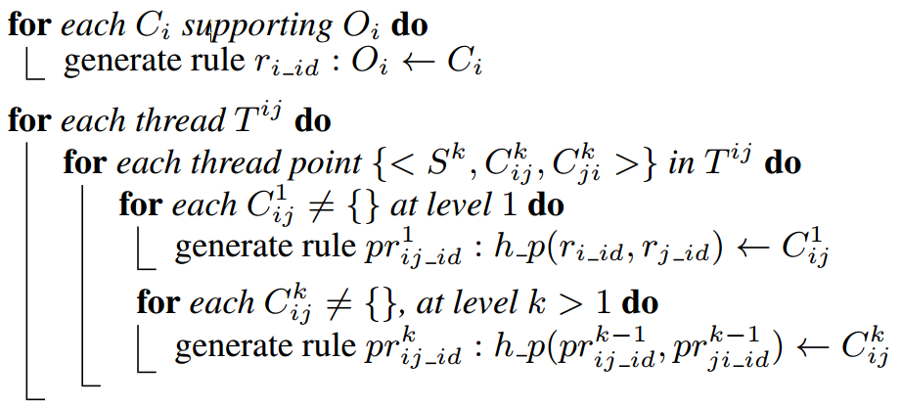
Algorithm for generating Argumentation Gorgias Code

Slide 15
Argumentation in Gorgias

Slide 16
Argumentation in Gorgias
Argumentation Framework of Gorgias
  Rules and Priorities rules (on rules)
Preference-based argumentation framework
  Logic Programming with Negation as Failure (LPwNF)
    Proposed in 1994 (KMD at ICLP94)
LPwNF used in the study of various problems
  Autonomous Agents (Computees in SOCs)
  Machine Learning (Non-monotonic learning)
  Reasoning about Actions and Change (Event Calculus and Language E)

Slide 17
Argumentation framework of LPwNF
Language of LPwNF
  Rules and Priorities on rules
    Conditional priorities
    Higher-order priorities, i.e. priorities on priorities
    C.f. Prakken & Sator, 1997: Legal Reasoning & Argumentation
Uniform argumentation process for object-level and priority arguments
  Start argumentation at the object-level to support a decision
  Continue arguing at the meta-level on the relative strength of the arguments at the previous level.
Uniform inclusion of abductive reasoning within the AF

Slide 18
Argumentation framework of LPwNF
Arguments are tuples (or sets) S=(O,P)
  O – object level Extended LP rules (without NAF)
  P – priority rules on rules of O and P
  Either S’ renders a rule in S’₁ higher priority over a rule in S₁
  Or the rules in S’₁ and S₁ are non-comparable w.r.t. S’ and S
Attacking relation:
  S attacks S’ iff there exist L and S₁ ⊆ S, S’₁ ⊆ S’ s.t.:
    B ∪ S₁ ⊢_{min} L and B ∩ S’₁ ⊢_{min} L^{c}
    S₁ ⊒ S’₁ (If S₁ has a rule of lower priority then it also has one of higher priority)

Slide 19
Temporal Reasoning
(Reasoning about Actions)
Arguments in A are:
  generation rules:
    holds (F,T₂) ← initiation(F,T₁), T₁ < T₂
    ¬ holds (F,T₂) ← termination (F,T₁), T₁ < T₂
  persistence rules:
    holds (F,T₂) ← holds (F,T₁), T₁ < T₂
    ¬ holds (F,T₂) ← ¬ holds (F,T₁), T₁ < T₂
  assumption rules: holds (F,T ), ¬ holds (F,T )
Priority < is given by:
  persistence rules < later(or =) & conflicting generation rules
  generation rules < later & conflicting generation rules
  assumptions < conflicting generation rules

Slide 20
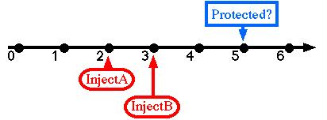
Example – Vaccinations
Demo Gorgias
InjectA initiates Protected when {TypeO}
InjectB initiates Protected when {¬TypeO}
InjectA happens-at 2
InjectB happens-at 3

Slide 21
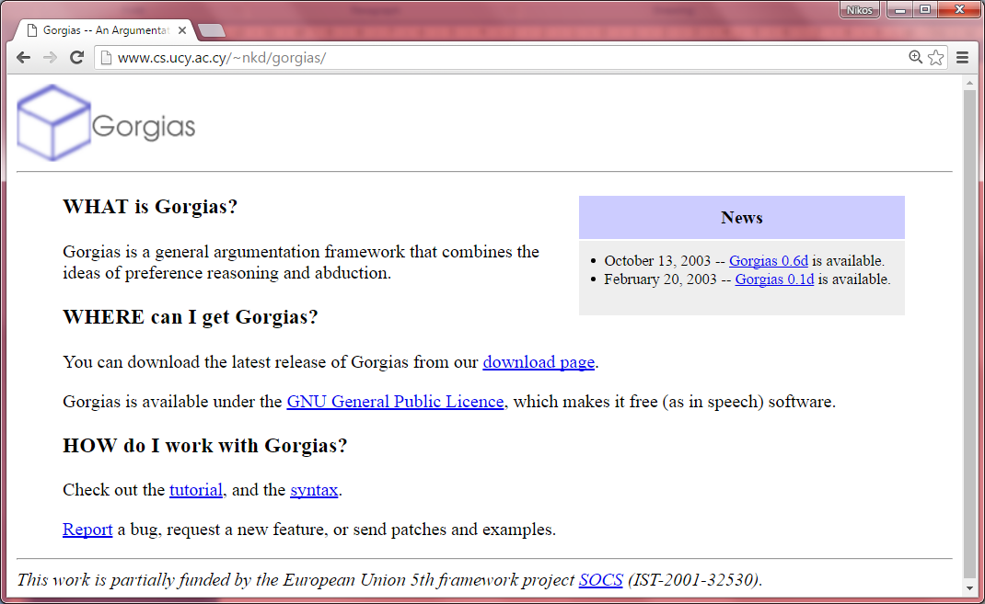
The Gorgias System

Slide 22
Applications of Gorgias
(2003- …)
Ambient Intelligence: Ambient Assisted Living (AAL)
Ambient Intelligence: Pervasive Services and Conflict resolution in sensors
Business Computing: Product Pricing
Business Computing: Portfolio Construction
Network Security: Management of Firewall Policies
Medical Informatics: Deep Vein Thrombosis
PROSOCS platform for KGP agent: Intra-agent control

Slide 23
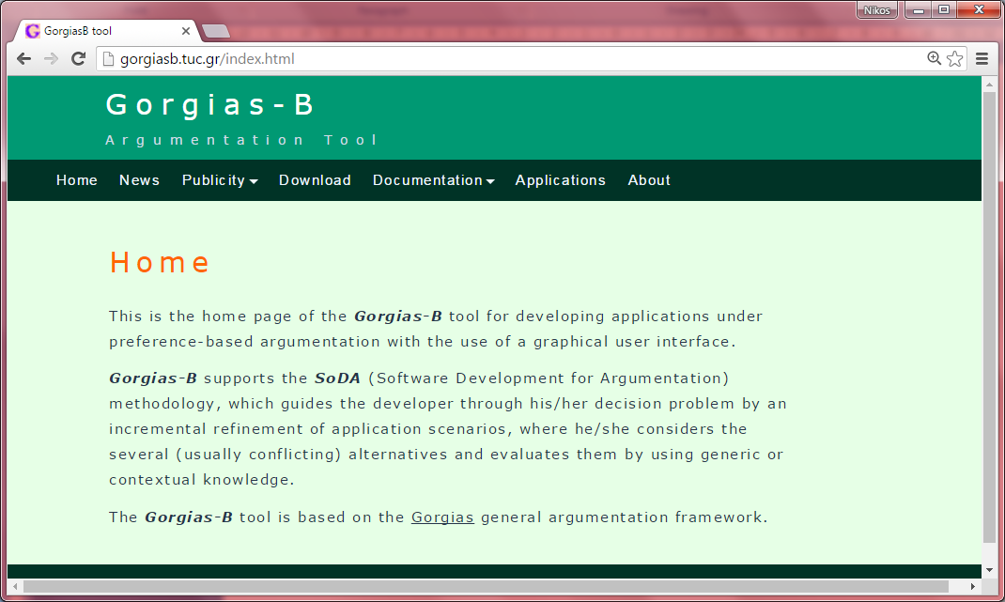
The Gorgias-B web site

Slide 24
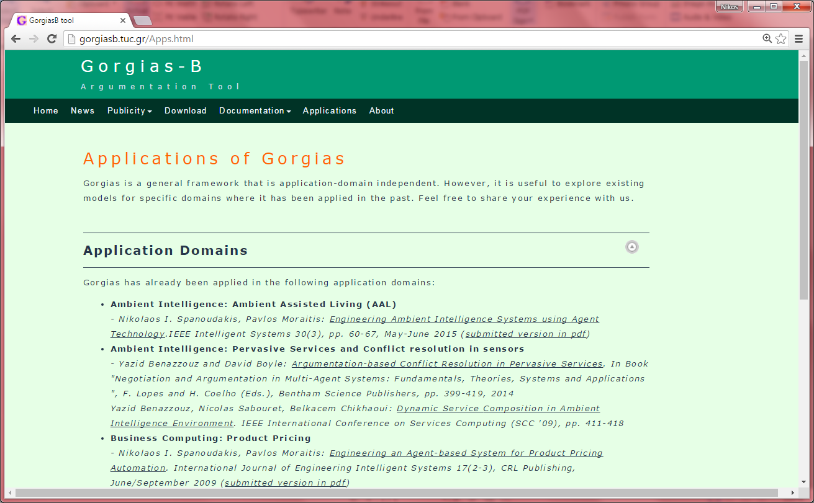
Applications

Slide 25
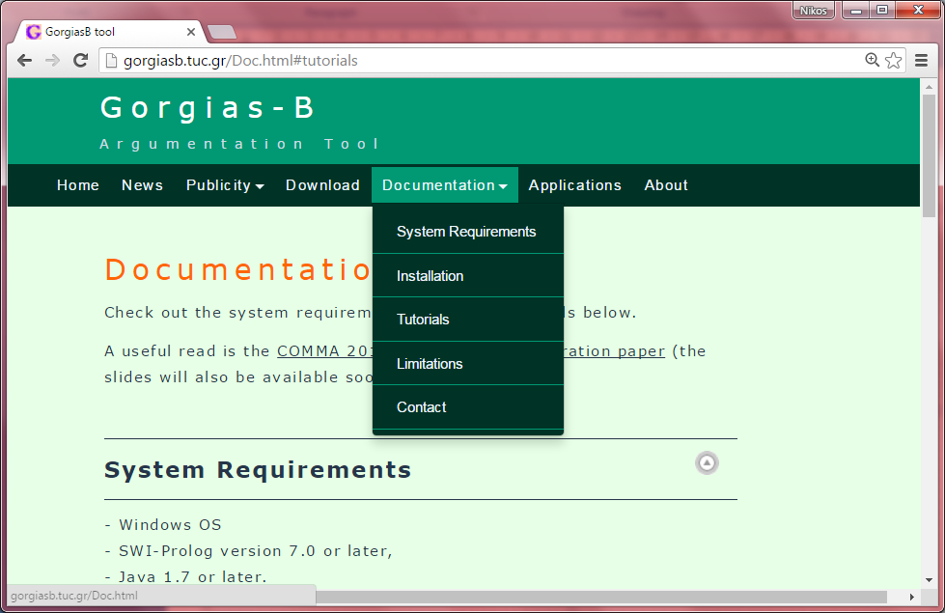
Find out more
http://gorgiasb.tuc.gr/

Slide 26
Conclusions
Cognitive expression of expected result(s) in an ever more specific problem scenarios corresponds naturally to an argumentation theory (in the LPwNF – LPP framework).
Facilitates applications of argumentation.
Gorgias-B (www.gorgiasb.tuc.gr) is a tool to support this.

Slide 27
Cognitive Assistants via
Argumentation
Cognitive Assistant Architecture:
  Strategy Module
  World Knowledge Module (Beliefs and assumptions)
Strategy Module: seen this in the demos.
World Knowledge Module:
  Similar argumentation based representation:
    Common sense knowledge (Including Reasoning about Actions)
    Expert knowledge (in high-level cognitive terms)
  Supported by SoDA (and Gorgias-B) in the same way.
  MINED FROM THE WEB FROM UNSTRUCTURED (text) DATA.

Slide 28
Future Work
Improve system of Gorgias
  Web-service
New applications (with Imperial College – Resilient Information Systems Security group)
  Security: Distributed Firewalls and Data Access
  Data sharing agreements
  Cyber attack attribution
Cognitive Programming – Cognitive Assistant applications
  Based on Comprehension through Argumentation
    STAR system (http://cognition.ouc.ac.cy/star)

